Slide 1

COMP207 Project
AANSS
Welcome
ClubDB Project

Slide 2
AANSS
Contents
Navigating the insandouts of Q&A
ins and outs the Project
INTRODUCTION
PROJECT TIMELINE
PROJECT DETAILS
QUERIES

Slide 3
COMP207 Project
AANSS
Introduction

Slide 4
COMP207 Project
AANSS
Why a Club DB?
Because most of us go to clubs and use the club’s services, and never really thought about how the data is stored or how the data is structured and how things operate behind the scenes from training subscriptions to employee management and it really does highlight the importance of database systems for businesses like clubs, it helps in event planning
(which you’ll see later in the queries), guiding members to specific places where a specific food/drink is served and other things like keeping digital records of professional player contracts and much more.
We think that a club represents a good way to show what we learned from this course and has good query options (even though it has so much data).

Slide 5
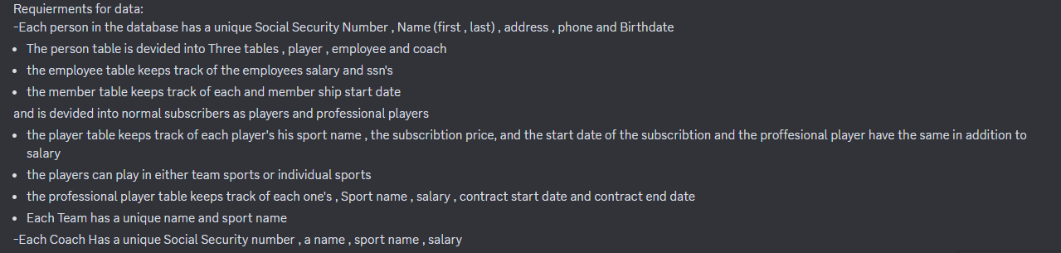
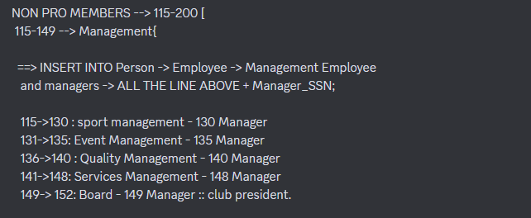
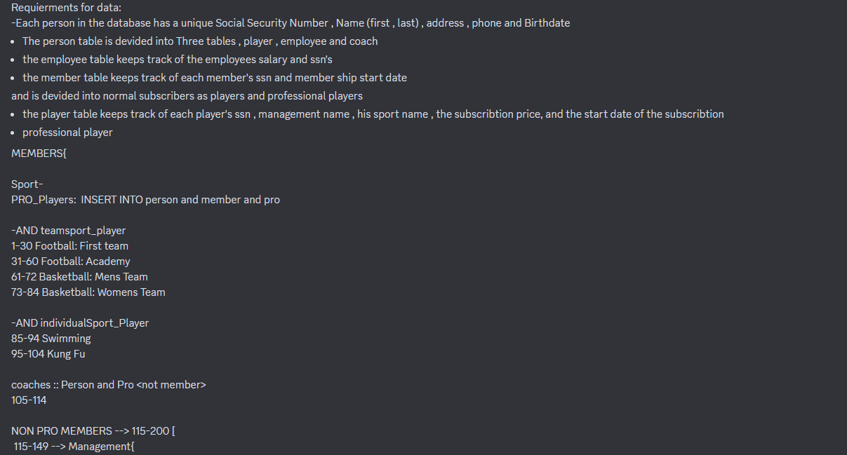
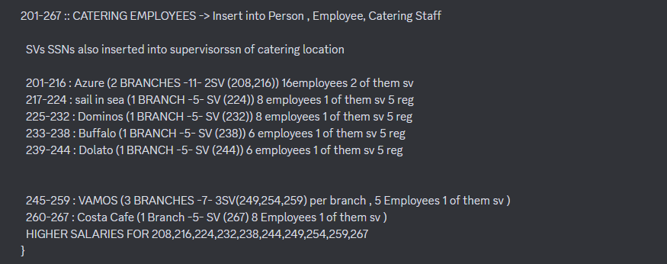
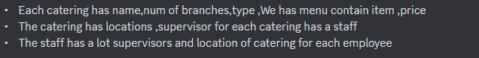
COMP207 Project
AANSS
Requirements

Slide 6
COMP207 Project
AANSS
Requirements
More can be found in Ta2seema.txt on The GitHub repo.

Slide 7
AANSS
Our Team
AANSS
Ahmed Khaled
Ahmed Ashraf
Noureen Ahmed
Seif Mohamed
Sherif Lotfy

Slide 8
COMP207 Project
AANSS
Supervisors
Dr.Wael Zakaria
Dr.Mohamed Hashim

Slide 9
COMP207 Project
AANSS
Timeline
Brainstorming
Mapping/Modelling
Query Creation
Trying to find Ideas for the project.
Mapping the Tables and Relationships’ EER and RM
Writing Various Queries for things in the DB

Slide 10
COMP207 Project
AANSS
Mapping
EER & RM
Using Draw.io we mapped out the Enhanced Entity Relationship diagram, and the Relational Model for the tables and relationships we initially had in mind. Lots of things were changed in the process while we were working on the relationships so there’s quite a few versions in the archive which can be found on our GitHub Repository.

Slide 11
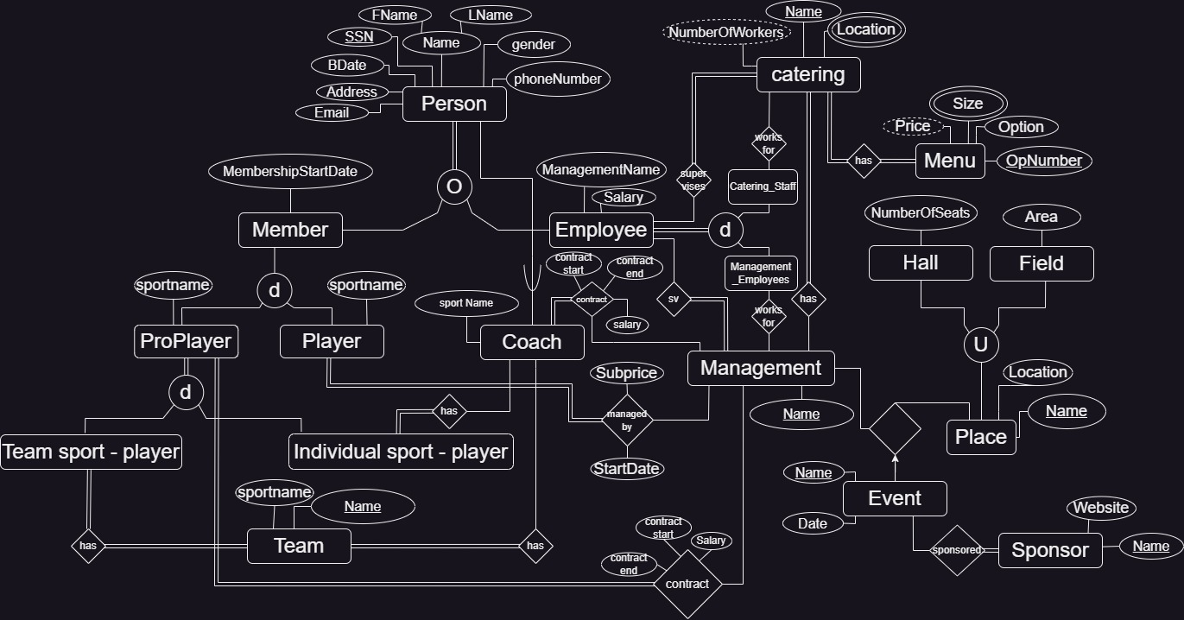
COMP207 Project
EER&RM
1. EER Enhanced Entity Relationship

Slide 12
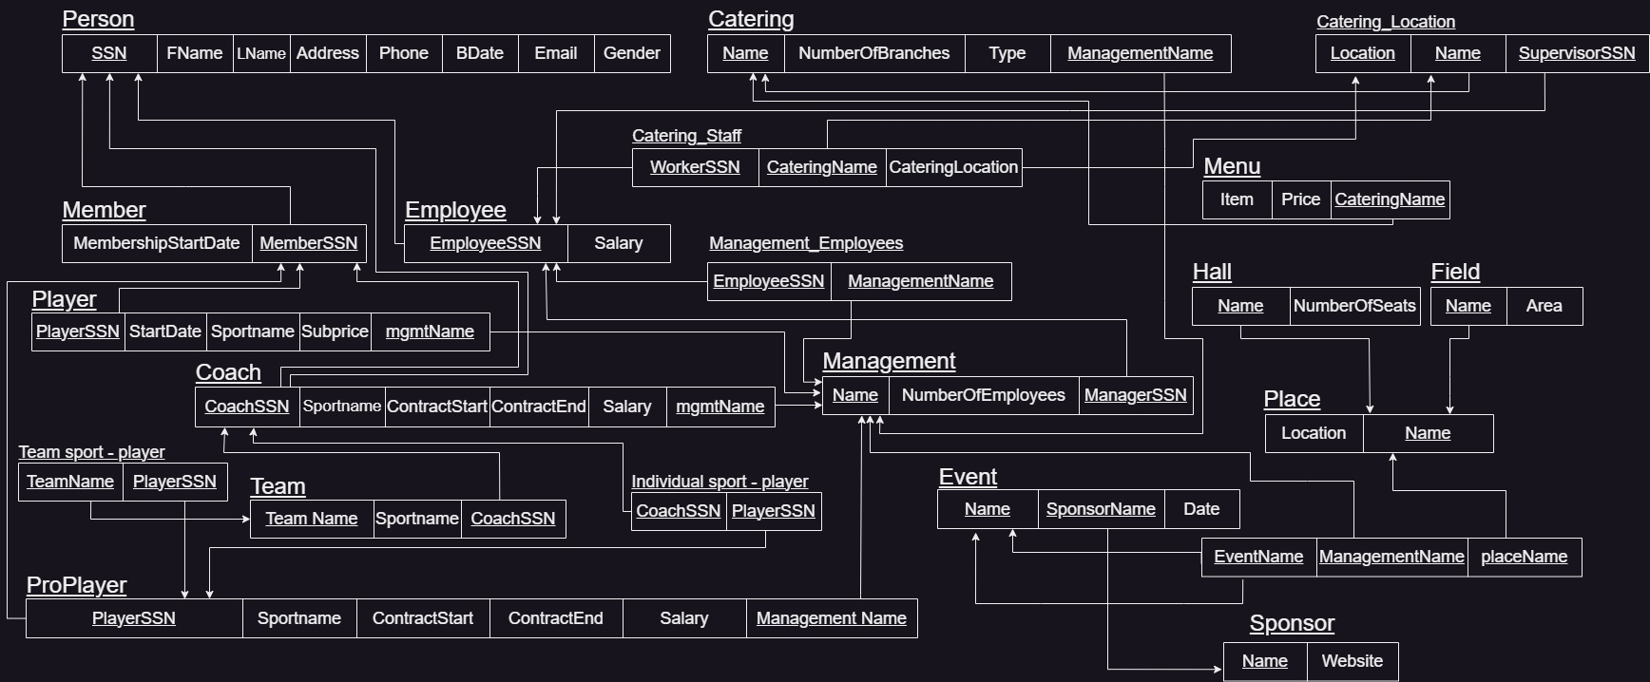
COMP207 Project
EER&RM
2. RM Relational Model

Slide 13
COMP207 Project
AANSS
Workbench
Modelling
Basically taking what we previously made with the tables and relationships in the EER and Relational Model and making it in MySQL Workbench while minding all the relations stuff in workbench (which is annoying to work with by the way), and again we had multiple versions of this because of how many times we changed things in the EER and thus Relational Model, all of which are on the repository

Slide 14
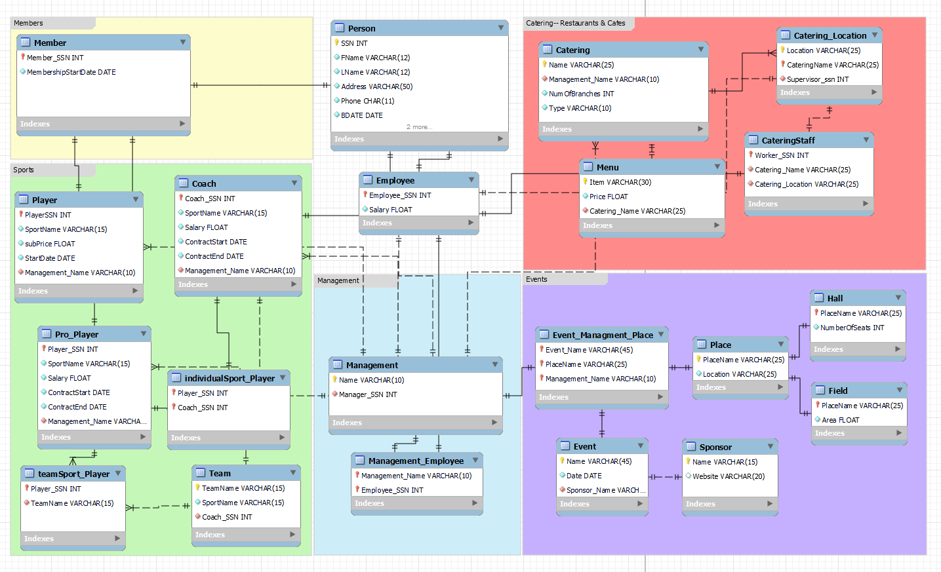
COMP207 Project
WB Model
The WMB File also contains the inserts and data that is associated with each table, which there is a lot of data for a club and with this many tables.

Slide 15
COMP207 Project
AANSS
Data &Inserts
Out of everything so far, this is probably what took the most time, determining the data sets for everything individually and then creating that data, which for example the person table contains 347 Inserts, which if done manually would take a huge amount of time so we built a script which outputs randomly generated data from provided names, streets etc.. , But for every group we need specific edits, for example: the football academy team, you’d have to edit the script to only get people of a certain age range so they’d be a fit for the team.

Slide 16
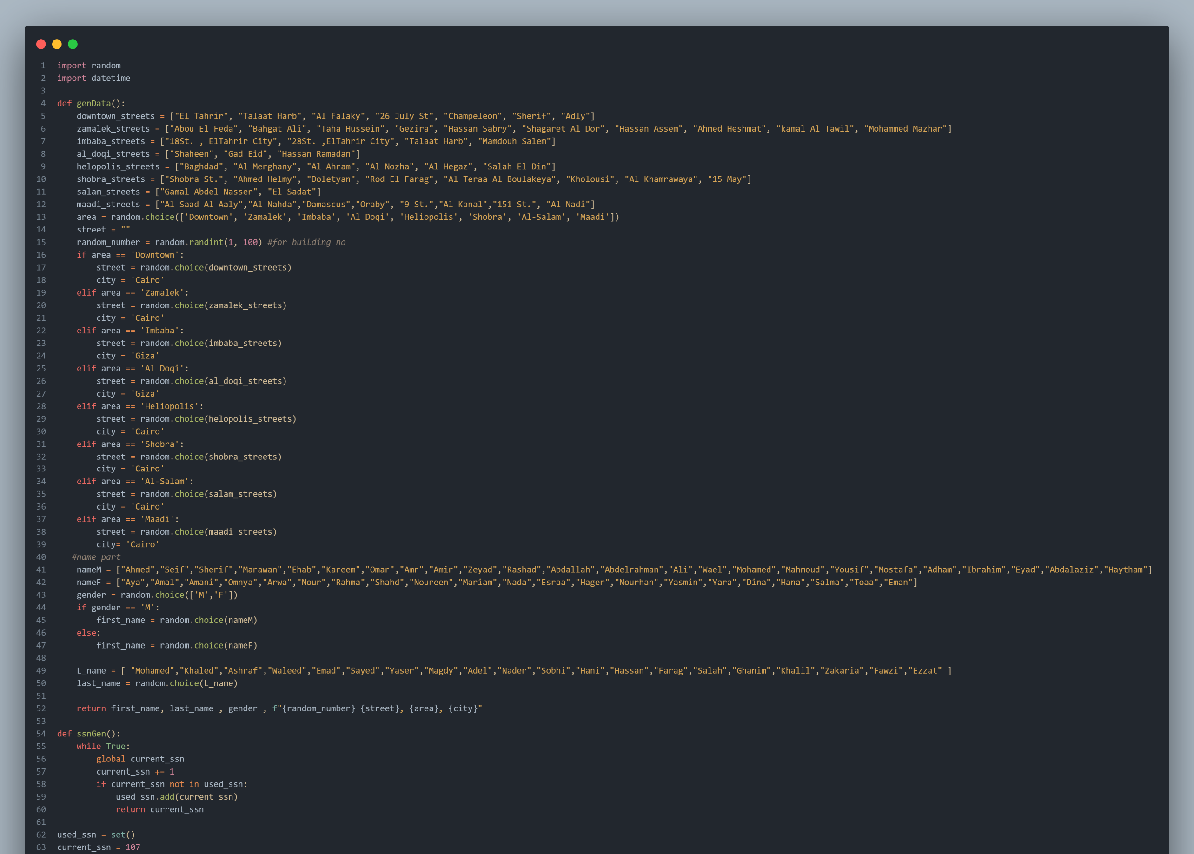
COMP207 Project
AANSS
Data Gen
Script
This is a snippet of the base script that just generates random data for the rows of the person
Full script and all variations and outputs can be found in the DataGens directory on the GitHub repo.

Slide 17
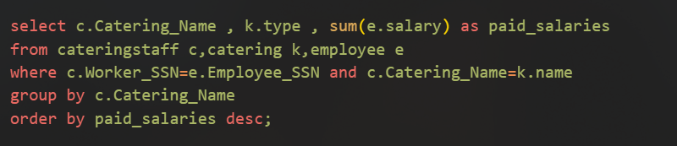
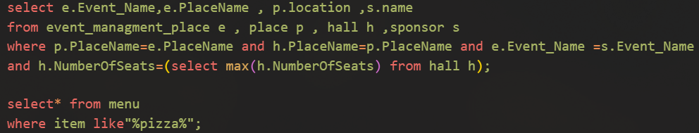
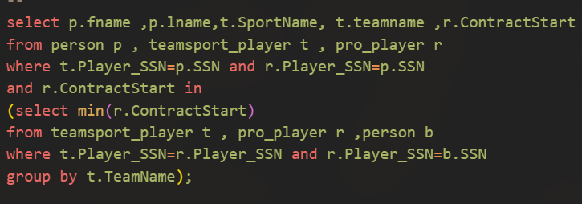
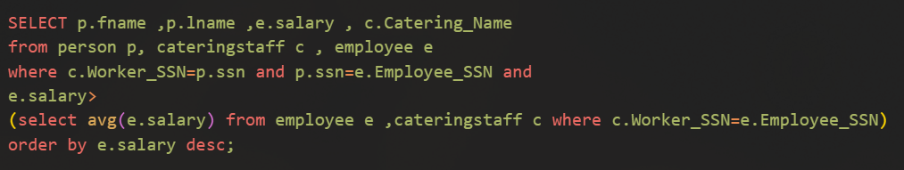
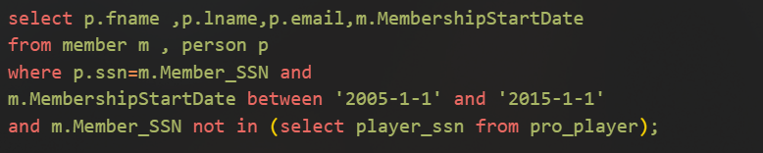
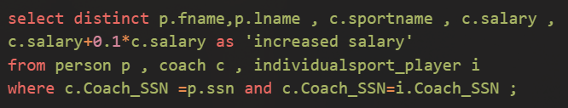
COMP207 Project
AANSS
Queries
We Wrote 22 Queries that find (Mostly) Relevant data for normal

Slide 18
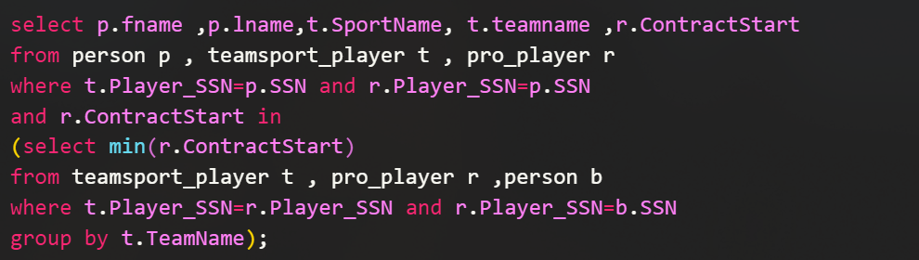
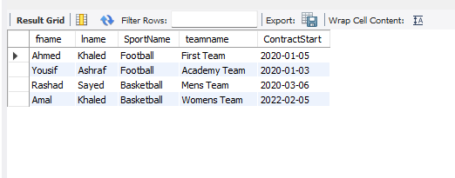
COMP207 Project
Query 1
Retrieves the oldest player in each team

Slide 19
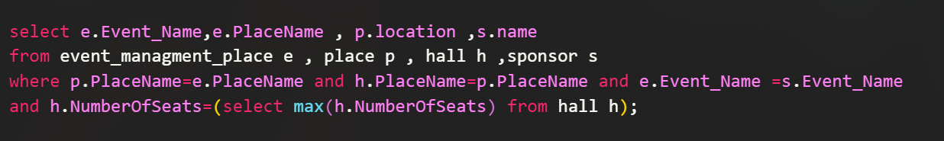
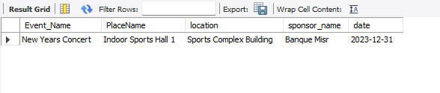
COMP207 Project
Query 2
Retrieves the biggest hall to hold new years concert event

Slide 20
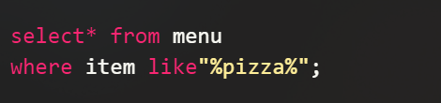
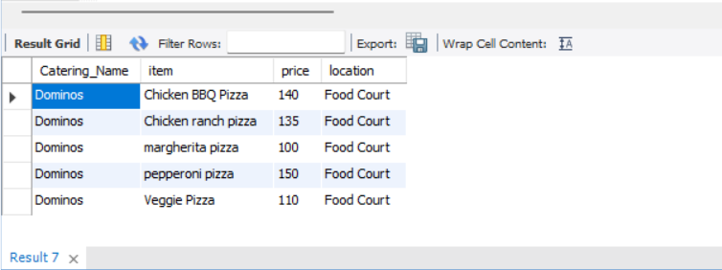
COMP207 Project
Query 3
Retrieves Data of Menu Items including ‘Pizza’

Slide 21
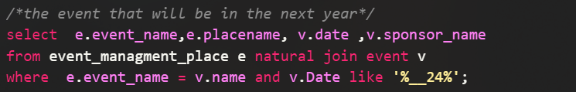
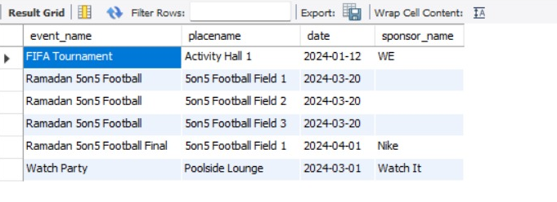
COMP207 Project
Query 4
Retrieves all of next years events

Slide 22
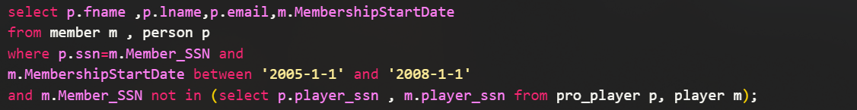
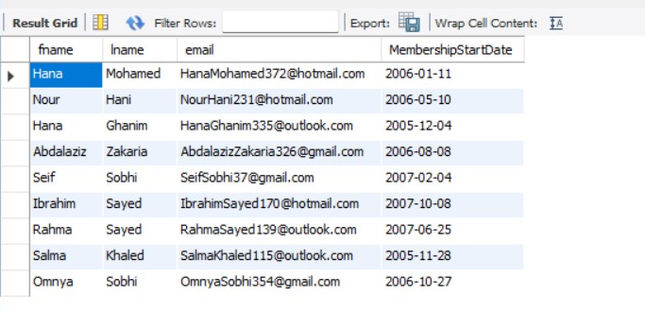
COMP207 Project
Query 5
The non pro player member whose membership more than 3 years since 2005

Slide 23
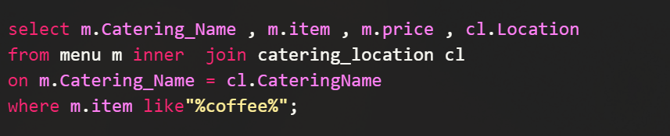
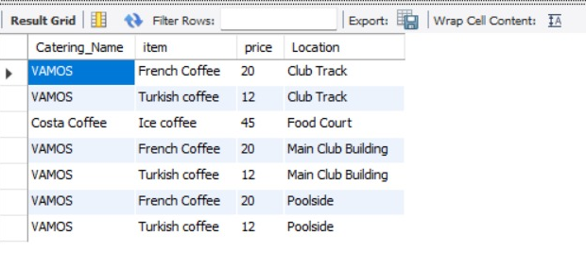
COMP207 Project
Query 6
Retrieves the Restaurants or cafes who have coffee in every branch

Slide 24
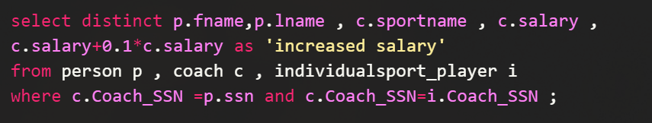
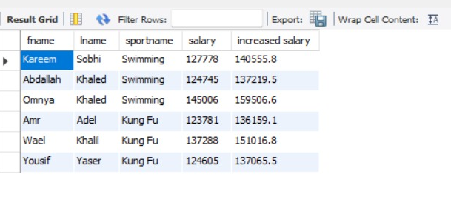
COMP207 Project
Query 7
Add a 10% to salary for every coach who train player in single sport

Slide 25
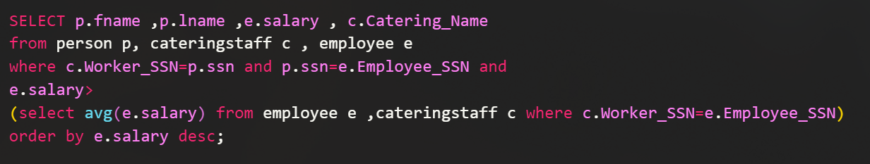
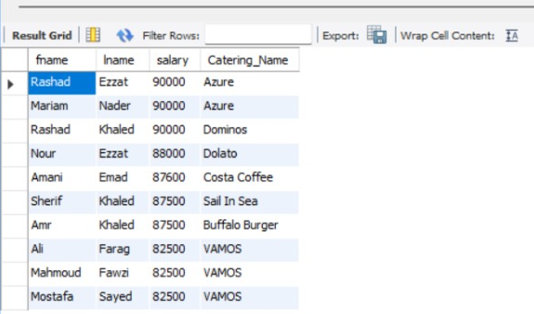
COMP207 Project
Query 8
Retrieves Employee Data for employees who make more than the average for each catering

Slide 26
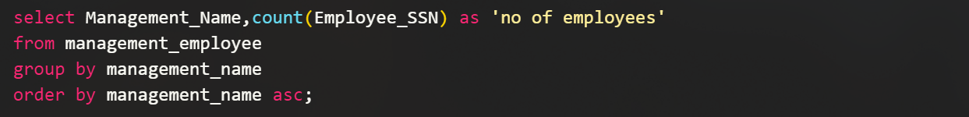
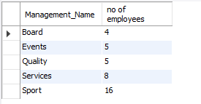
COMP207 Project
Query 9
Retrieves The number of employees in each managment

Slide 27
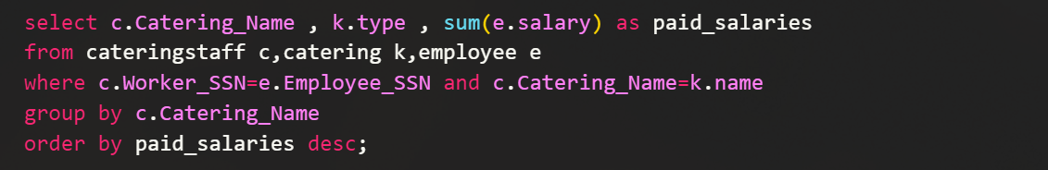
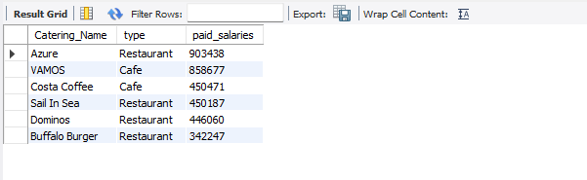
COMP207 Project
Query 10
Retrieves the paid salaries of employees for each catreing

Slide 28
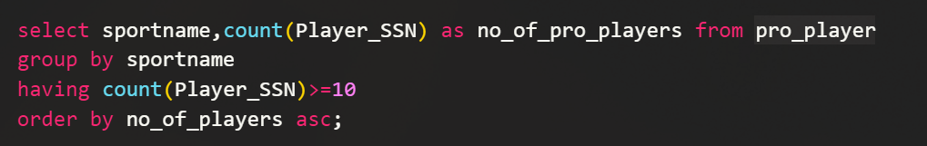
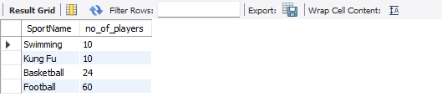
COMP207 Project
Query 11
Retrieves number of pro players for each sport

Slide 29
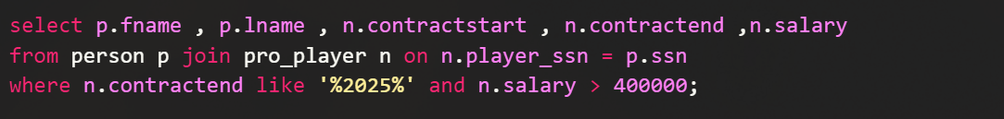
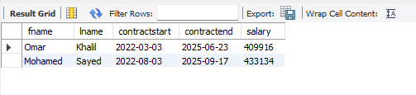
COMP207 Project
Query 12
Retrieves Pro Players’ data whose contract ends in 2025, and salary above 400000 / yr

Slide 30
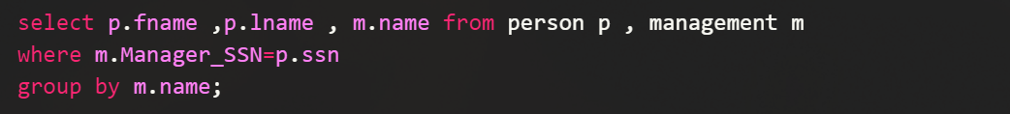
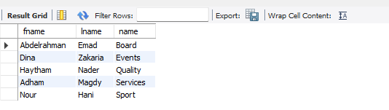
COMP207 Project
Query 13
Retrieves name of manager of each management

Slide 31
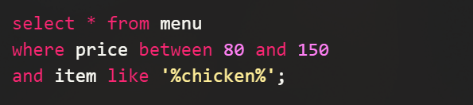
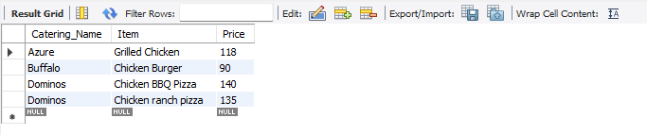
COMP207 Project
Query 14
Retrieves all food items including ‘Chicken’ and price between 80 and 150

Slide 32
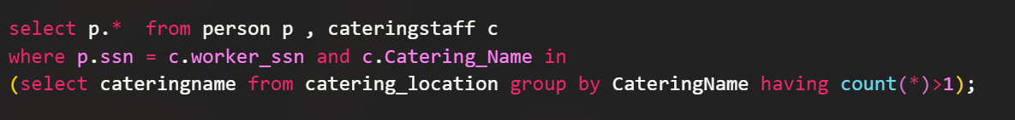
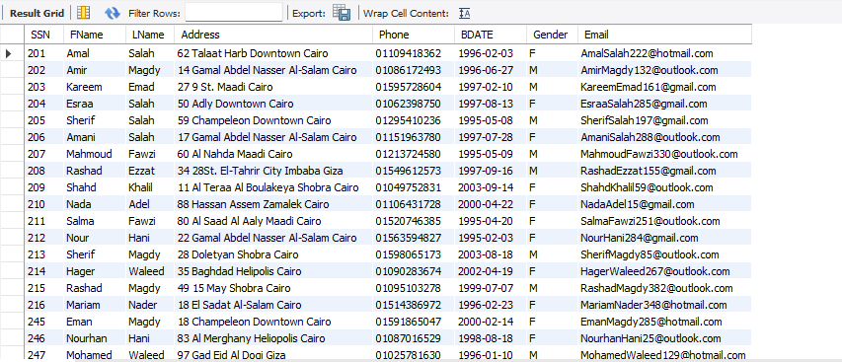
COMP207 Project
Query 15
Retrieves Employees of Restaurants/Cafes that have more than one branch

Slide 33
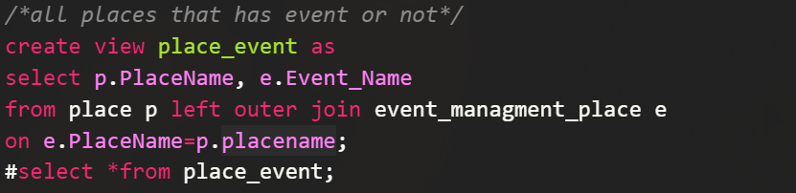
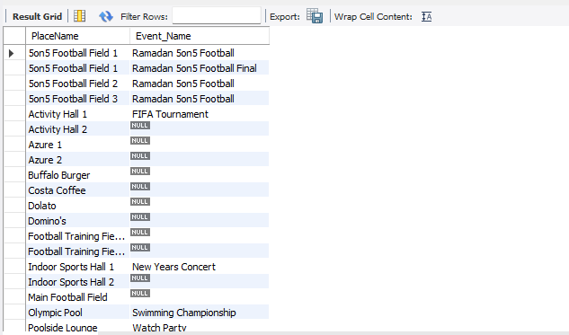
COMP207 Project
Query 16
Retrieves All places, whether they have an event or not, note: Run everything before # 1st

Slide 34
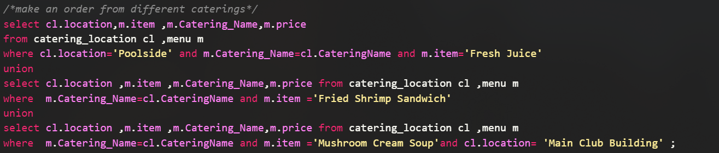
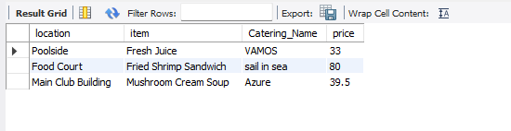
COMP207 Project
Query 17
Retrieves an order from different caterings and of different types of food/drink

Slide 35
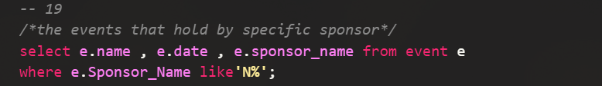

COMP207 Project
Query 18
Retrieves Event data for events sponsored by a sponsor whose name begins with N

Slide 36


COMP207 Project
Query 19
Retrieves number of Female and Male Players (non pro)

Slide 37


COMP207 Project
Query 20
Retrieves Members living in a street called Talaat Harb, (2 streets with the same name)

Slide 38


COMP207 Project
Query 21
Retrieves the details of supervisors for vamos in each branch

Slide 39


COMP207 Project
Query 22
Retrieves the fields hosting the Ramadan 5 on 5 football tournament, and final game.

Slide 40
COMP207 Project
AANSS
Thank you!
We hope you liked our work on this project!

